Slide 2
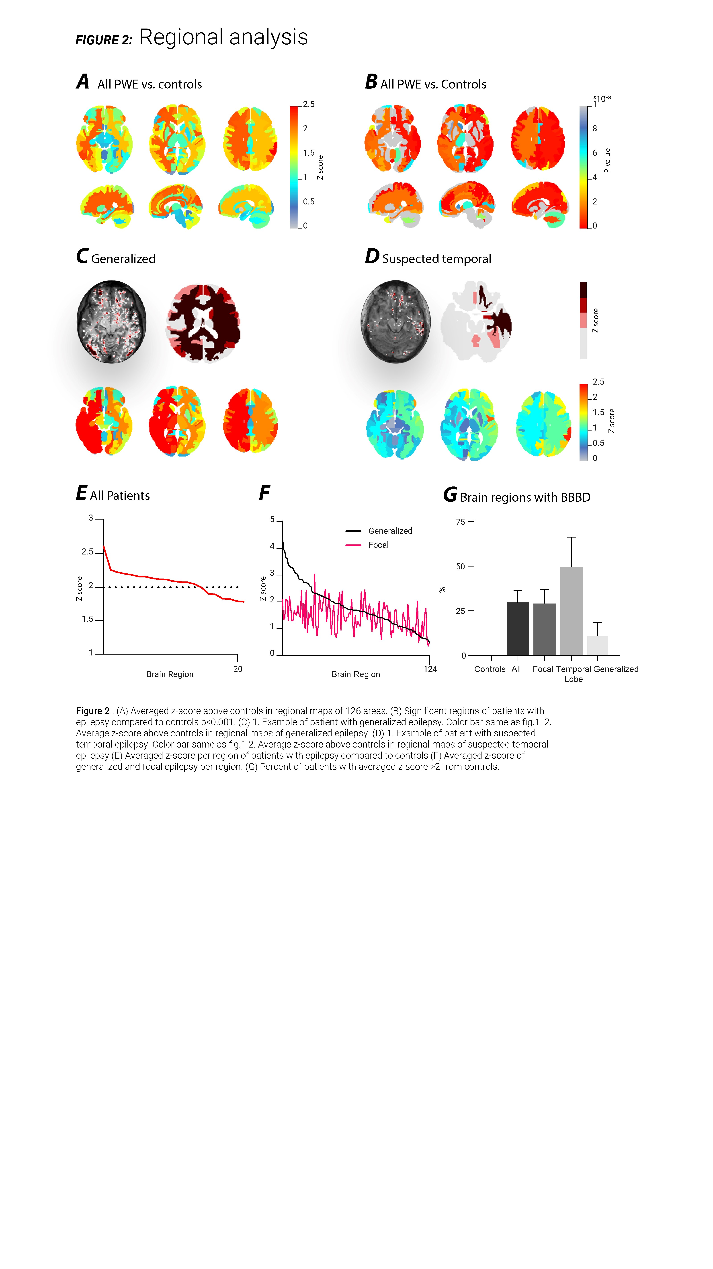

Slide 3
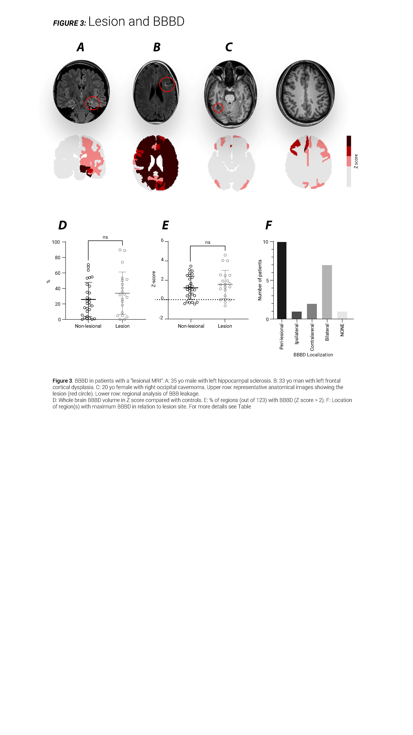

Slide 4
A Age
B Gender
C Age of onset
D Years of epilepsy
E Seizure frequency
F Medication

Slide 5
All PWE
Focal PWE

